Slide 1

SIH-1720-Education & Awareness - Effective Use of Technology for Dissemination of Anti-Doping Information
Department of Computer Science and Engineering
BATCH-26
GUIDE
HOD
R.Harthika - 217Y1A0583
Syed Suhana - 217Y1A05C4
Y.PRASHANTH
Assistant Professor
Dr . K. Abdul Basith
Notes:
ID=d924773e-9a16-4d6d-9803-8cb819e99682 Recipe=text_billboard Type=TextOnly Variant=0 FamilyID=AccentBoxWalbaum_Zero

Slide 2
INDEX
Abstract | 3
Objectives | 4
Literature Survey | 5
System Architecture | 6
Existing System | 8
Proposed System | 10
Design | 12
Conclusion | 14
References | 15

Slide 3

ABSTRACT
he SIH-1720 project seeks to revolutionize the education and awareness surrounding anti-doping measures by harnessing cutting-edge technology. Aimed at a diverse audience, including athletes, coaches, support personnel, and sports administrators, the initiative will develop innovative digital platforms to disseminate crucial information effectively. By creating engaging educational content such as interactive videos, infographics, and quizzes this project will address the specific needs and concerns of various stakeholders, ensuring that the information is both accessible and relevant.Collaboration with anti-doping experts, nutritionists, and sports psychologists will enhance the scientific accuracy of the materials, while gamification elements will increase engagement and motivation among users.

Slide 4
OBJECTIVES
Predictive Risk Identification: Utilize AI models to analyze historical and real-time data to predict potential doping incidents before they occur.
Real-Time Monitoring: Enhance the system's capability to provide real-time tracking of athlete engagement and behavior, enabling quicker responses to potential risks
Advanced Anomaly Detection: Employ AI algorithms to identify unusual patterns or behaviors in athlete performance and drug testing data that may indicate doping risks.
Automated Alerts and Notifications: Develop a system for real-time alerts about changes in doping regulations, educational content updates, or personal progress to keep athletes informed.

Slide 5
LITERATURE SURVEY
Conducting a literature survey on the effective use of technology for the dissemination of anti-doping information involves reviewing existing research, studies, and reports that examine how various technological tools and platforms can enhance education and awareness about anti-doping regulations and practices. Below is a structured approach to this literature survey, along with some key themes and findings from relevant literature.
Historical Context of Anti-Doping
Evolution of Anti-Doping Policies: Review the development of anti-doping regulations from the early 20th century to the establishment of the World Anti-Doping Agency (WADA) in 1999.
Key Milestones: Discuss significant events, such as the introduction of the World Anti-Doping Code and major doping scandals that shaped public perception and policy.

Slide 6
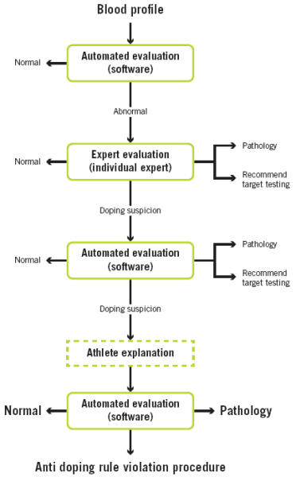
SYSTEM ARCHITECTURE

Slide 7
ALGORITHMS USED
Content Recommendation Algorithms
Natural Language Processing (NLP) Algorithms
Machine Learning Algorithms
Gamification Algorithms
Data Analytics Algorithms
Social Media Algorithms
User Feedback and Survey Algorithms

Slide 8

EXISTING SYSTEMS
The existing system for anti-doping monitoring and information dissemination relies mostly on traditional methods and manual processes. These systems are typically focused on ensuring athletes comply with anti-doping regulations but may lack advanced AI-based features for deeper monitoring, analysis, and personalized education.
Manual Detection Methods: Doping detection relies heavily on traditional drug testing procedures like urine and blood tests, which are analyzed in labs using predefined criteria.
Limited Data Analysis: Current systems have limited capabilities for advanced data analytics. They rely on predefined patterns to detect anomalies in drug testing data without learning from new data
Limited Feedback and Reporting: Reporting and feedback mechanisms are not AI-driven, meaning they rely on manual surveys or reports, which may not provide deep insights into learning outcomes or risks.

Slide 9
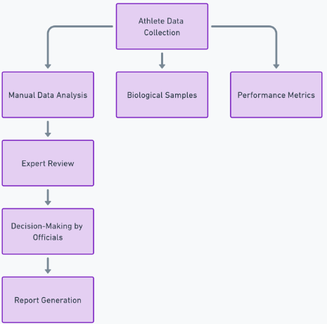
EXISTING SYSTEMS ARCHITECTURE

Slide 10
LIMITATIONS OR DRAWBACKS
Limited Reach and Accessibility
Language Barriers
Engagement and Retention Challenges
Lack of Interactivity
Insufficient Customization
Inflexibility
Technological Limitations
Outdated Platforms
Privacy Concerns
Sustainability and Funding
Short-Term Funding
Limited Collaboration
Lack of Stakeholder Involvement

Slide 11

PROPOSED SYSTEM
The proposed system integrates AI-based monitoring and analysis tools, enabling real-time, data-driven decision-making and personalized education tailored to each athlete’s risk profile and engagement levels. It significantly improves detection, prediction, and prevention of doping incidents.
AI-Driven Predictive Models: The proposed system utilizes machine learning and AI models to predict potential doping incidents based on historical and real-time data, enabling a proactive approach to anti-doping measures.
Real-Time Alerts and Notifications: The system can automatically send alerts and notifications about changes in anti-doping regulations, educational content, or personal progress via mobile apps and web platforms
Video and Performance Analysis: AI can analyze video footage of athletes’ performance to detect unusual patterns or sudden improvements that may signal doping use. Computer vision and pose estimation tools are used here.

Slide 12
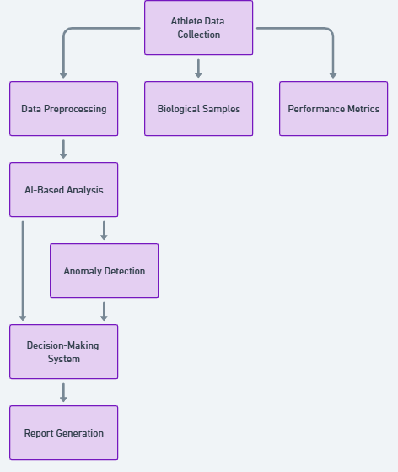
PROPOSED SYSTEM ARCHITECTURE

Slide 13
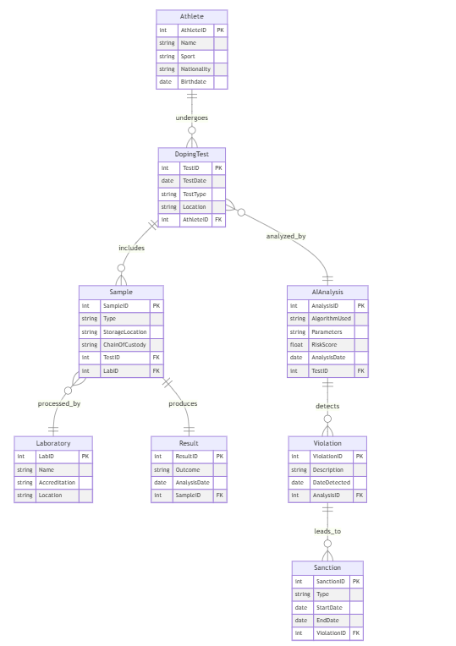
DESIGN
ER-DIAGRAM

Slide 14
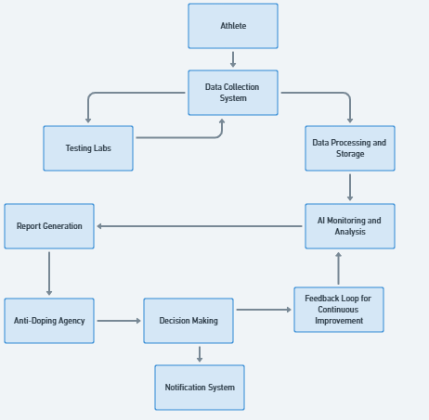
DFD DIAGRAM

Slide 15
CONCLUSION
In conclusion, the proposed AI-based monitoring and analysis tools represent a significant advancement in anti-doping education and awareness. By leveraging predictive analytics, personalized learning experiences, and real-time monitoring, the system aims to proactively identify potential doping risks and engage athletes effectively. This innovative approach fosters a deeper understanding of anti-doping measures, enhances compliance, and ultimately promotes integrity in sports, creating a fairer and safer environment for all athletes while reducing the prevalence of doping incidents.
The analysis tools will significantly enhance anti-doping education and awareness by enabling predictive insights, personalized learning experiences, and real-time monitoring. This innovative approach empowers athletes and organizations to proactively combat doping, ensuring a fairer and safer sporting environment for all participants.

Slide 16
REFERENCES
[1] Chatbots and Conversational AI: The Complete Guide" by Vittorio Banfi Published: November 2020
[2] Designing Bots: Creating Conversational Experiences" by Amir Shevat Published: May 2017
[3] Artificial Intelligence: A Guide for Thinking Humans by Melanie Mitchell
[4] AI-Powered Chatbots for Business by Jason Chapman Published, July 2018
[5] React - The Road to React: Your Journey to Master Plain Yet Pragmatic React.js" by Robin Wieruch, December 2018

